Slide 1
Workload profiling for AI4Research
An early exploration: what we measured, what we cannot see yet on the GB10 (DGX Spark), and where to spend time next
Exploratory briefing. No GB10 results yet
Notes:
TIME 0:20
SAY: Main points:
- This is an exploration, not a plan to build
- The goal is to decide where our time is best spent

Slide 2
SHORT ANSWER
The short answer, before the detail
Question | Where we are
What is the idea? | Record each capsule's GPU behaviour alone (a quiet window: nothing else on the GPU), then look it up when many things run at once
Does it matter in M1? | Maybe not much: capsules call a remote model, so remote wait likely dominates. It could matter for local models, experiment code, the benchmark capsule and later parallel nodes
What have we measured? | On a different machine (RTX 5070 Ti; imported report, unaudited): tasks have very different GPU fingerprints, heavy jobs slowed LLM decode about 2x, and cheap runtime levers are large. Nothing on the GB10 (DGX Spark)
Suggested next | 1. Trace one real run, no GPU window. 2. Probe what the GB10 can show. Decide who does them and by when: not set yet
A quiet window is where device-wide GPU counters belong to one job. Every number in this deck is from our other machine unless it cites NVIDIA, a paper or the design package
Sources are on the slides that follow. Measured on our other machine (RTX 5070 Ti), imported report, unaudited, n=2 to 12: sources/2026-10-16-shared-gpu/report.md
2
Notes:
TIME 1:00
SAY: Main points:
- The honest answer to whether this matters in M1 is: maybe not much
- In M1 every capsule calls a remote model, so waiting on it likely dominates
- It could matter once there are local models, experiment code and parallel nodes
- Our numbers are from a different machine, so they show what can happen, not what will happen on the GB10
- The first two steps are cheap and tell us whether the rest is worth doing

Slide 3
FIRST QUESTION
First question: how much does AI4Research use the local GPU?
Capsules | Where the work runs | GPU declared | Contention case
Intent, requirements, planner, search, screening, hypothesis, evaluation, delivery, verifier | Fixed Codex CLI route: remote model | None | None locally. Wall time is remote wait
research.builder | Codex CLI plus the POC code it runs in its workspace | None (poc_workspace write) | Depends on the experiment it writes: unmeasured
research.benchmark | Local tool on the GB10 | gpu_device exclusive, wall_s 3600 | Never paired by declaration. Peak memory measured at first pilot
Later | Local models behind the router, parallel branches (outside M1 per planner.md:216) | Per model and capsule | Where pairing and model residency could matter
Likely M1 answer: the bottleneck is remote Codex wait, which GPU profiling cannot predict. Step 1 checks: trace one real run into remote wait, CPU, local GPU, I/O
design-package/1-system.md (fixed Codex route), reference/examples/*_capsule.json, capsules/research-benchmark.md:29, capsules/builder.md:36
3
Notes:
TIME 1:15
SAY: Main points:
- In M1 every capsule runs through the fixed Codex route, so most wall time is remote model wait
- Only the benchmark capsule declares a GPU, and it is exclusive, so it is never paired
- The builder runs experiment code whose GPU use we have not measured
- Pairing and model residency matter only with local models and parallel branches, which planner.md:216 puts outside M1
- So the first question is how much of a real run is local GPU time at all
Supplemental points:
- Resource facts come from the example declarations in the design package

Slide 4

WHAT A PROFILE WOULD HOLD
Tasks have very different GPU fingerprints
• LLM decode is memory-bound: 78% DRAM, 0% tensor, tiny kernels (median 2.5 us, 193k launches/s)
• Prefill and training use compute: tensor 13 to 18%, kernels 7 to 77 us
• Speech-to-text and NVENC barely touch the GPU (0 to 3%)
• Decode beside training collides on memory and time. Speech or NVENC beside anything is nearly free
Measured on our other machine (RTX 5070 Ti), imported report, unaudited, n=2 to 12: sources/2026-10-16-shared-gpu/report.md (table B.5: each task alone; kernel figures from table B.4)
4
Notes:
TIME 1:15
SAY: Main points:
- This is what a profile record would hold, using real numbers from our other machine, each task run alone
- Decode reads the whole model per token, so memory is busy and tensor cores are not
- Prefill and training lean on compute and tensor cores
- Speech-to-text and NVENC leave the GPU almost idle in our test, so pairing them costs little
- Which pairs collide follows from these fingerprints, and our pair matrix agrees in direction
Supplemental points:
- Kernel median 2.5 us for 3B decode, 77 us for CNN training fp32, from table B.4
- Percentages are device counters during a solo run, so they belong to that task only because nothing else ran

Slide 5

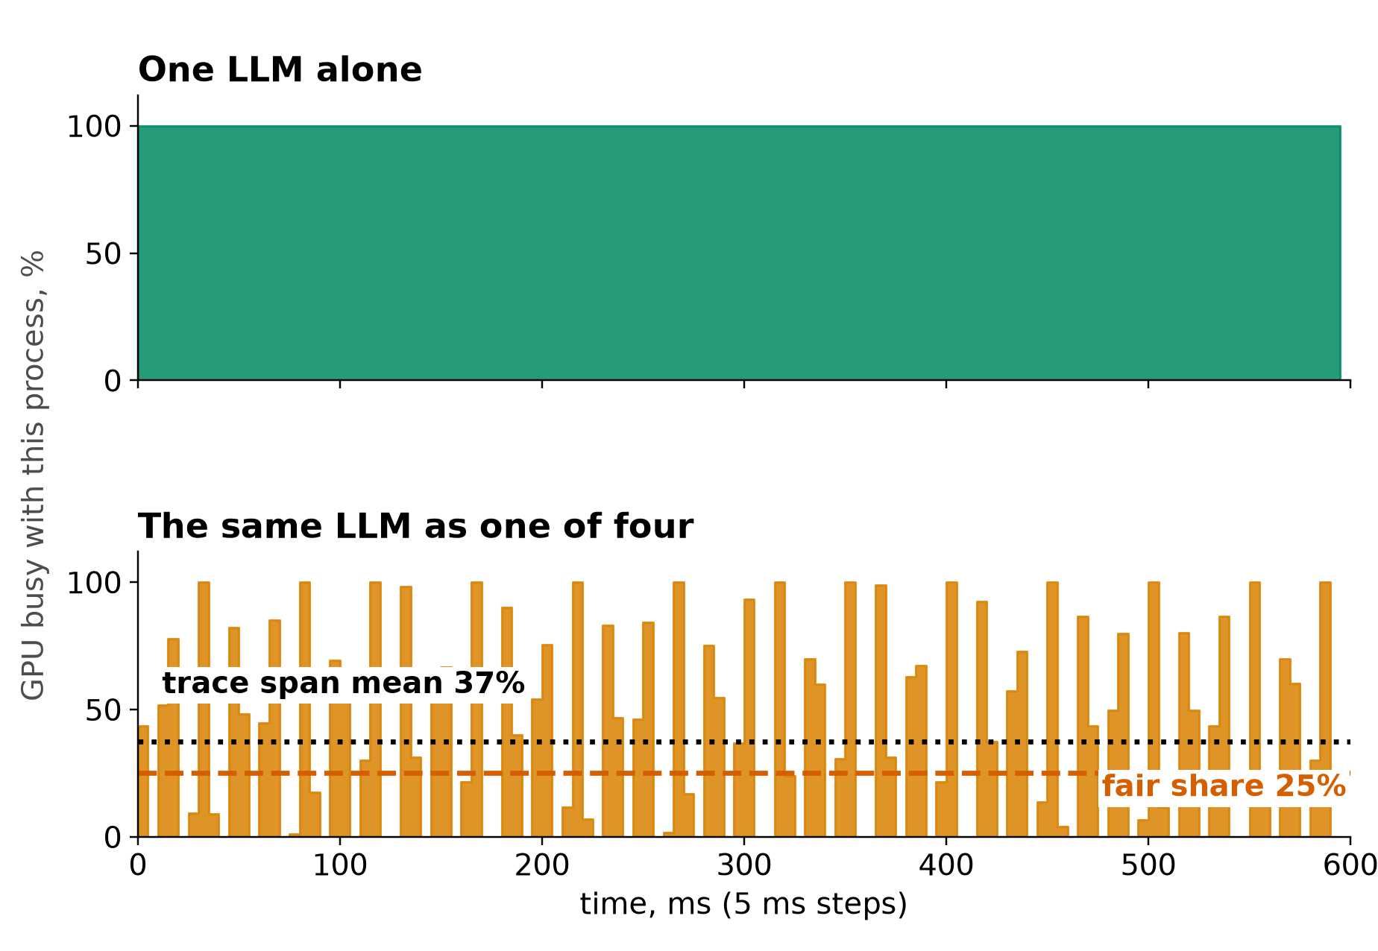
MEASURED ON OUR OTHER MACHINE
Measured contention: pairs, and four LLMs together
Left: pair slowdowns (n=2; LLM+LLM n=8; range x1.7 to x2.4 for LLM beside training). Right: one of four LLMs makes 22 to 26% of solo throughput, 91% in total. Trace span reads 37%
Pair = two jobs on the GPU at once. Decode = generating text token by token. NVENC = hardware video encoder. Trace span = how long each kernel is in flight
Measured on our other machine (RTX 5070 Ti), imported report, unaudited, n=2 to 12: sources/2026-10-16-shared-gpu/report.md (Fig. 6, 7; tables B.1, B.2). Discrete card: costs may differ on unified memory
5
Notes:
TIME 1:30
SAY: Main points:
- Left: each row task compared with its own solo run while the column task runs beside it
- LLM decode slowed about x2.08 beside CNN training, x2.27 beside another LLM, and training slowed only x1.16
- Right: one LLM alone against one of four identical LLM processes, kernel trace, 600 ms
- The trace span averages 37% because a span includes time switched out
- Mean stream makes 63.4 of 283.5 tokens per second, so the four together make 91% of one alone
- All of this is a discrete RTX 5070 Ti, not the GB10
Supplemental points:
- Speech-to-text and NVENC stayed between x0.98 and x1.12
- Four processes total 258 tok/s against 284 for one

Slide 6

LEVERS ALREADY VISIBLE
Four cheap runtime levers show up in our data
None of these needs the GB10 to act on. Model quality for routing is not measured
Measured on our other machine (RTX 5070 Ti), imported report, unaudited, n=2 to 12: sources/2026-10-16-shared-gpu/report.md (tables B.1 and B.8). Shapes should carry to other machines; milliseconds depend on the CPU
6
Notes:
TIME 1:15
SAY: Main points:
- Keep models loaded: first token takes 6.1 s from disk, 2.7 s from RAM, 0.05 s when resident
- Share the GPU-code cache across containers: a fresh container took 64 s without it and 5 s with it
- Batch requests in one process instead of one process per request: 614 against 258 tokens per second, and 2.5 against 8.9 GiB
- Reuse warm containers for short tasks: 49 ms for docker exec against 219 ms for docker run with the GPU
Supplemental points:
- On the GB10 the memory-related levers may behave differently, see the caveat slide
- Batch 8 gave 1,417 tok/s and is flagged for a recheck

Slide 7
HOW OTHERS DO IT
Industry shares GPUs by declared class or quota
Who | How they share | What it assumes | Lesson for us
NVIDIA time-slicing | Replicas of one GPU; workloads take turns | No memory or fault isolation between replicas | Matches our turn-taking loss
NVIDIA MIG | Hardware partitions with static profiles | Supported GPUs, planned partitions | Needs preflight on the GB10
ByteDance MuxFlow | Online (latency-critical) and offline jobs; offline throttled to protect online | Each job is classed online or offline | A declared class can work at scale: GPU utilization 26% to 76%
Alibaba cGPU | Per-container GPU memory and compute isolation | Memory quota requested per pod | A declared quota, not a prediction
Common pattern: sharing is decided by a declared class or quota, not a per-kernel prediction. That supports starting with a simple GPU-heavy flag
NVIDIA GPU Operator docs (time-slicing); MuxFlow, arXiv 2303.13803 (ByteDance); Alibaba Cloud ACK cGPU docs. Last column is our reading
7
Notes:
TIME 1:00
SAY: Main points:
- NVIDIA's own time-slicing has no memory or fault isolation, MIG has hardware isolation with static profiles
- ByteDance's MuxFlow splits jobs into online and offline and throttles offline work, and reports GPU utilization going from 26% to 76%
- Alibaba's cGPU gives each container a memory quota and isolates compute
- All of them rely on a declared class or quota, which is our one-bit flag idea
Supplemental points:
- MuxFlow figures are from its abstract as reported by search results, check the paper before quoting
- MPS is not shown here because the official page was not checked in this round

Slide 8
CAVEAT
The GB10 differs: what may change, what we do not know
Finding | Measured on discrete card | On the GB10 | Status
Decode is bandwidth-bound | 7B at 87 to 96% of measured ceilings | Ceiling lower, shared with CPU | Expected to carry over
Batching beats separate processes | 614 vs 258 tok/s | Same weight-reuse argument | Expected to carry over
CPU work takes GPU bandwidth | Not applicable, separate memory | Likely the main new interference | Untested
Process switching cost | 2 to 22% of GPU work lost across 3 pairs (DRAM read) | Needs remeasuring | Unknown
Model load | First token 6.1 s disk, 2.7 s RAM, 0.05 s resident | May converge, no PCIe copy | Unknown
Partial CPU offload | 7B with 20 of 28 layers on the GPU: 157 down to 22 tok/s | PCIe cliff goes away | Unknown
Memory accounting | 16 GB dedicated. File cache charged to the first container that reads it | 128 GB shared. Whether cgroups see GPU allocations is unproven | Unknown
GB10 = one 128 GB LPDDR5x pool, 273 GB/s, shared by CPU, GPU and OS; nvidia-smi shows Memory-Usage Not Supported (NVIDIA DGX Spark docs)
Measured on our other machine (RTX 5070 Ti), imported report, unaudited, n=2 to 12: sources/2026-10-16-shared-gpu/report.md, Limits section; NVIDIA DGX Spark hardware and known-issues pages. Nothing here is measured on a GB10
8
Notes:
TIME 0:45
SAY: Main points:
- Everything measured so far is x86 with a separate GPU over PCIe
- Shapes of bandwidth-bound decode and batching should carry over, absolute numbers will not
- CPU work competing for GPU bandwidth is the main new effect and has no test yet
- Switching cost, load times and offload need a GB10 run before anyone relies on them
Supplemental points:
- Cross-machine differences cannot be credited to unified memory alone

Slide 9
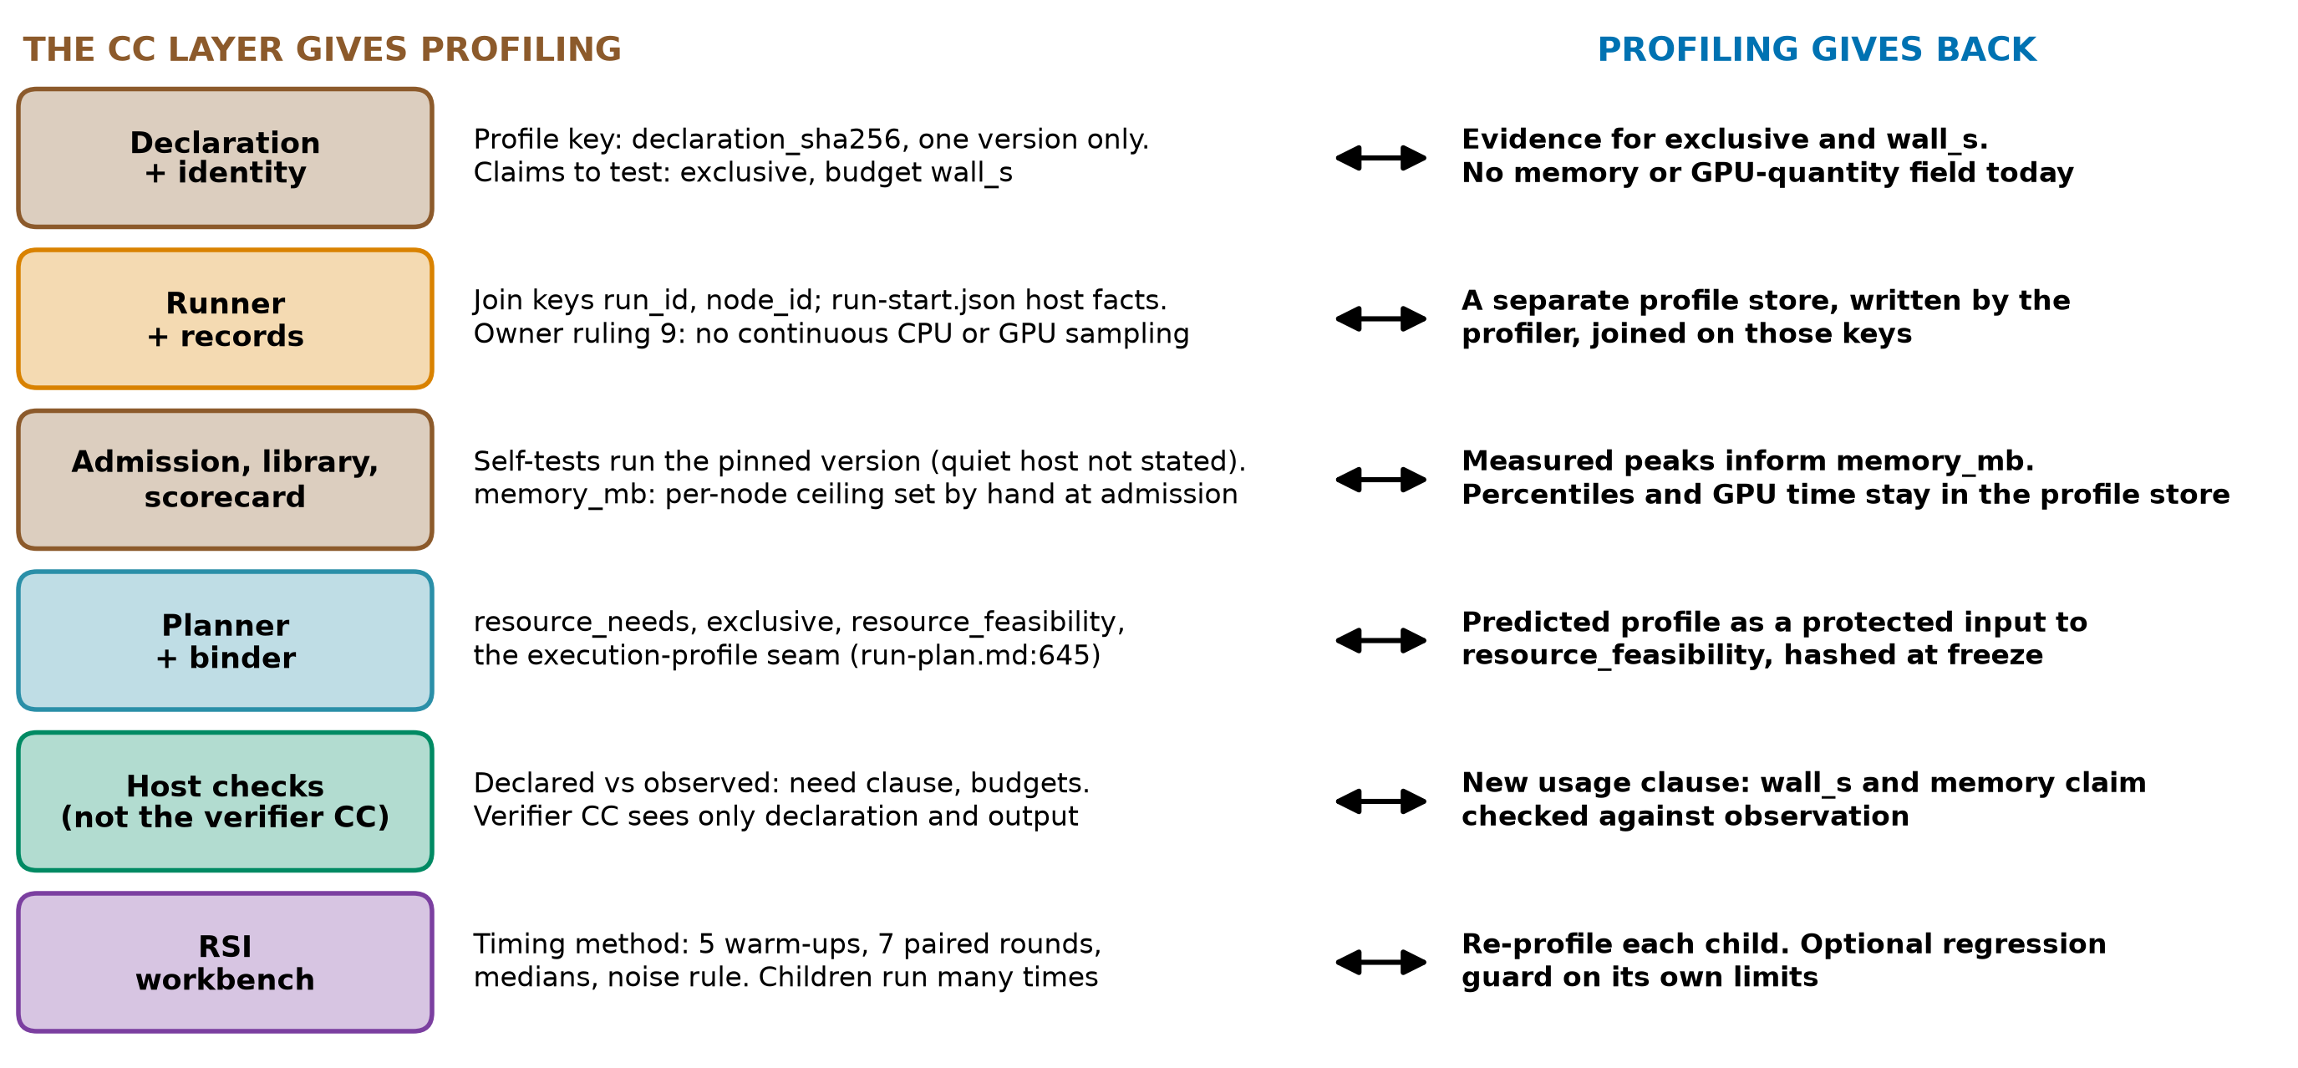
THE CAPSULE LAYER
The CC layer and profiling feed each other
design-package/reference/declaration.md, reference/derived-records.md, reference/run-plan.md:645, checking/README.md:29, side-systems/rsi-workbench.md:174
9
Notes:
TIME 1:30
SAY: Main points:
- The declaration identity, declaration_sha256, would be the profile key, so a profile belongs to one version
- The runner records join keys and host facts, but owner ruling 9 rules out continuous GPU sampling in run capture
- Admission self-tests run the pinned version, and memory_mb is set by hand today
- The planner has an execution-profile seam, a prediction would need a new protected input
- Host checks can compare declared with observed. The verifier capsule cannot, since it sees only declaration and output
Supplemental points:
- The declaration can name gpu_device exclusive and has wall_s, but no memory or GPU quantity field
- RSI timing: 5 warm-ups, 7 paired rounds, medians, more than 3x calibrated noise

Slide 10
WHERE TO SPEND TIME
Candidate questions, cheapest first
Question | Cheapest first step | If the answer is...
How much of a real run is local GPU? | Trace one real run: remote wait, CPU, local GPU, I/O. No GPU window | Small: drop pairing, keep routing and experiments
What can the GB10 show us? | Probe DCGM, Nsight, MIG, cgroups. Do cgroups see GPU memory? | Little: keep timing and memory records only
Does CPU work slow GPU work in the shared pool? | CPU memory-streaming job beside LLM decode | Yes: matters for routing and planning
Do solo profiles say anything about pairs? | A few pairs on the GB10, against a simple GPU-heavy flag | No better than the flag: use the flag
How many local models, and which? | Residency and batching on the GB10. Quality needs its own test | Input to router design
Can the CC schema carry resource facts? | Talk to the declaration, planner and sidecar owners | Needs their decisions
Decision for this meeting: do questions 1 and 2, and name who does them and by when (not set yet)
gb10-profiling-plan.md phases A to D; development-tools/sidecar/README.md:103,107; side-systems/owner-rulings.md:123; method/decisions.md D35. Order is by cost, not importance
10
Notes:
TIME 1:15
SAY: Main points:
- These are candidate questions, ordered by how cheap they are to answer
- The first needs no GPU window and could shrink the whole topic
- The second tells us which records are even possible on the Spark
- The third is the main new effect on unified memory and has no test yet
- The last needs decisions from other owners, so it comes after we know what is worth asking for
Supplemental points:
- Sidecar README line 107 and owner ruling 9 currently limit profiling
- Sizing is not given on purpose: it depends on the first two answers

Slide 11
Appendix
Extra measurements, proposals, limits and sources
Notes:
TIME 0:05
SAY: Main points:
- Backup material, shown only on request

Slide 12
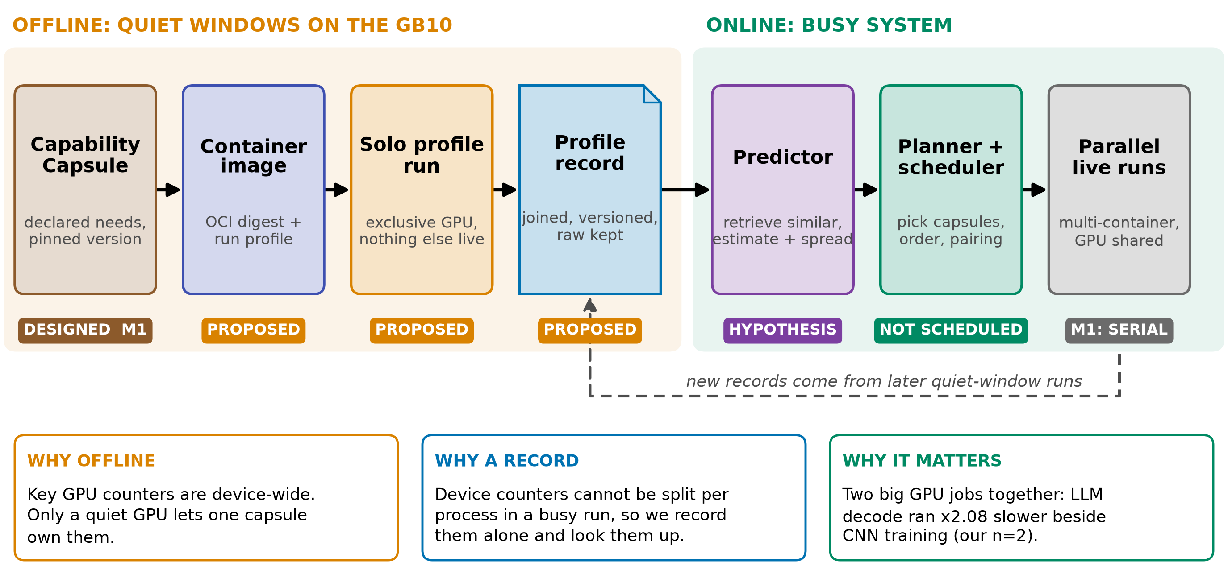
APPENDIX
The idea in one picture
Status: exploratory. Measured so far: one x86 machine (RTX 5070 Ti), imported report, raw traces not yet reviewed. Not done: any GB10 (DGX Spark) run, any predictor
gb10-profiling-plan.md; planner seam: design-package/reference/run-plan.md:645
11a
Notes:
INSERT: optional slide; delete or hide it and the talk flows unchanged
TIME 1:30
SAY: Main points:
- The idea has two halves: record each capsule alone on an idle machine, then use the records when many things run at once
- The reason: key GPU counters cannot be split per process while other jobs run
- The chips on the diagram say what exists: only the capsule declaration exists, the rest is an idea
- Everything measured so far is on a different machine from the DGX Spark
- The point of this talk is to decide what is worth trying first
Supplemental points:
- The sidecar benchmark runner does not cover this profiler (D36, D40)

Slide 13

APPENDIX
On GB10 the GPU shares one pool and dashboards go blind
NVIDIA DGX Spark hardware and known-issues pages; NVIDIA CUDA programming guide, Unified Memory section; copy speeds: Measured on our other machine (RTX 5070 Ti), imported report, unaudited, n=2 to 12: sources/2026-10-16-shared-gpu/report.md
11b
Notes:
INSERT: optional slide; delete or hide it and the talk flows unchanged
TIME 1:15
SAY: Main points:
- Discrete card: VRAM is a number and PCIe copies are measurable
- Unified Memory on a discrete card migrates pages on demand, we did not measure its cost
- GB10: 128 GB LPDDR5x at 273 GB/s shared by CPU, GPU and OS
- NVIDIA documents nvidia-smi Memory-Usage as Not Supported on iGPU, read MemAvailable instead
- Our numbers come from the discrete card and do not transfer
Supplemental points:
- Cross-machine differences cannot be credited to unified memory alone

Slide 14
APPENDIX
Device counters cannot be split per process; most else can
Tool | Split per process while others run? | Limit
nvidia-smi | Memory yes. Utilization only where pmon supports it | GB10: Memory-Usage Not Supported
DCGM (NVIDIA datacenter monitor): profiling, job stats, MIG | Profiling counters no: whole device. Job stats and MIG partly, GB10 unknown | 1 Hz default, conflicts with Nsight
Nsight (timeline and per-kernel profilers) | Yes, but kernel durations include time spent on others | Intrusive, replay perturbs the run
cgroups (Linux per-container accounting) | Yes | Host CPU, memory, I/O only
The SM, tensor and DRAM counters need the GPU alone. Process memory and cgroup data split under sharing. Kernel times split too, but inflated by time spent on others
Terms: SM = streaming multiprocessor (GPU compute block). MIG = GPU partitioning. pmon = nvidia-smi per-process monitor. Quiet window = nothing else uses the GPU
NVIDIA DCGM user guide (feature overview); DGX Spark known issues; gb10-profiling-plan.md:29-31; report.md:285-287
11c
Notes:
INSERT: optional slide; delete or hide it and the talk flows unchanged
TIME 1:15
SAY: Main points:
- DCGM says its profiling counters are device-level and conflict with Nsight
- Per-process memory and kernel timelines survive sharing, but kernel durations include time the GPU spent on others (report.md:286)
- So the quiet window is for SM, tensor and DRAM counters, not for everything
- DCGM job statistics and MIG might give more attribution, the Spark preflight decides
Supplemental points:
- Clouds attach pod labels to DCGM metrics, but the counters stay device-wide

Slide 15
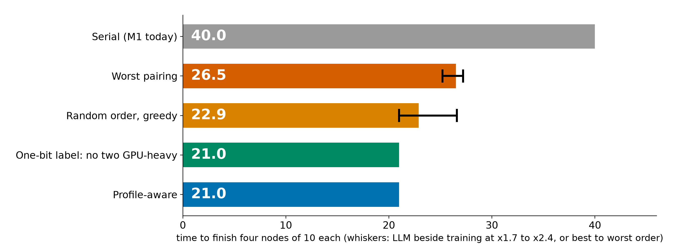
APPENDIX
Toy case: a simple label already finds the best pairing
• A one-bit label (a declared GPU-heavy flag, never two together) already matches profile-aware, if each node's class is known
• Partly by construction: with two GPU classes one flag suffices. Profiles earn their cost with many classes, and for memory and routing
• No benefit in serial M1: this matters only once parallel nodes exist (planner.md:216)
planner_baselines.py: fluid model, two slots, four nodes of 10, our n=2 pair slowdowns (RTX 5070 Ti, unaudited)
11d
Notes:
INSERT: optional slide; delete or hide it and the talk flows unchanged
TIME 1:15
SAY: Main points:
- Four nodes of equal length, A LLM, B training, C speech, D NVENC, at most two run at once
- Worst pairing 26.5, random order about 22.9, best 21.0, serial 40
- A one-bit GPU-heavy label picks the best pairing without any profile
- So the planner case for profiles is many classes, memory limits and routing, not this toy. Parallel nodes are outside M1
Supplemental points:
- Whiskers: LLM beside training at x1.7 to x2.4 moves the worst pairing from 25.2 to 27.2
- Orion (EuroSys 2024) co-schedules kernels by complementary resource use

Slide 16


APPENDIX
Routing hypothesis: few models, batched requests
4 separate processes: 258 tok/s and 8.9 GiB. Batched: 614 tok/s and 2.5 GiB. One request alone: 284 separate, 274 batched. Batch 8 is faster per token than 4 (n=2): recheck
First token of a 7B model: 6.1 s from disk, 2.7 s from RAM, 0.05 s resident. On the GB10 the weights come from the shared pool. Model quality is not measured
Measured on our other machine (RTX 5070 Ti), imported report, unaudited, n=2 to 12: sources/2026-10-16-shared-gpu/report.md (B.1, B.8). qwen2.5 3B, 256 tokens. Cold load is for a 7B model
11e
Notes:
INSERT: optional slide; delete or hide it and the talk flows unchanged
TIME 1:15
SAY: Main points:
- Left: separate processes each load their own weights, so memory grows with the number of copies
- Right: one process batching requests makes more tokens per second than several processes
- On the Spark the weights, the experiments and the OS share one pool, so fewer models leave more room
- This suggests the router should prefer a few resident models, but we measured cost only, not quality
- Routing is behind RouterPort with a fixed route today, so this is an input for later phases
Supplemental points:
- Bandwidth bound for decode is in the appendix
- MPS was not tested

Slide 17
APPENDIX
Four LLMs together make 91% of one alone
• Alone: trace span 100%, 3.5 ms per token
• One of four: span averages 37%, flickers 0 to 100% every 5 ms, 15.8 ms per token
• Trace span (how long each kernel is in flight) includes time switched out. Useful throughput per stream: 22 to 26% of solo, 91% in total
• Total output: 4 processes 258 tok/s vs one 284. A loss, not a split
Measured on our other machine (RTX 5070 Ti), imported report, unaudited, n=2 to 12: sources/2026-10-16-shared-gpu/report.md (Fig. 7, table B.1; 63.4 of 283.5 tok/s). Discrete card: the cost may differ on unified memory
11f
Notes:
INSERT: optional slide; delete or hide it and the talk flows unchanged
TIME 1:00
SAY: Main points:
- One of four identical LLM processes, kernel trace, 600 ms in 5 ms steps
- The trace reads 37% because a kernel's span includes time it was switched out
- Mean stream makes 63.4 of 283.5 tokens per second, which is 22% (range 22 to 26%), and the four total 91% of one alone
- Each token takes 4.5 times longer and the four together make less than one alone
- Discrete RTX 5070 Ti, not evidence about unified memory
Supplemental points:
- Trace span and device busy are different metrics: 100% alone against 91%

Slide 18

APPENDIX
Where a profile could attach, and where it must not
design-package/reference/run-plan.md:74-80,191,645; reference/declaration.md:41; development-tools/sidecar/README.md:103,107; side-systems/owner-rulings.md:123
11g
Notes:
INSERT: optional slide; delete or hide it and the talk flows unchanged
TIME 1:00
SAY: Main points:
- Five existing places cannot carry a prediction, each for a stated reason in the design
- The landing is a new protected input beside the resource inventory and plan policy, hashed at freeze
- Sidecar README line 107 says no profiling integration or product telemetry, and owner ruling 9 says no continuous CPU or GPU sampling in run capture. So this needs an owner decision
- The execution-profile seam is already named for parallel branches
Supplemental points:
- Sidecar launcher never pauses or preempts a core run

Slide 19
APPENDIX
Chip questions: what would be needed, much later
Question for a chip team | Controlled change needed | Output
How much does bandwidth matter? | Working-set and context sweeps; memory clock if exposed | Slope with interval
How much does compute matter? | Power cap, GPU clock, MPS thread percentage as an SM proxy | Slope with interval
Does CPU work take GPU bandwidth? | CPU streaming job beside decode | Slowdown curve
What do agent workloads look like? | Replay real capsule traces: bursts, tool waits, model swaps | Duty cycles
Why here: the long-term aim is to inform chips for agentic systems. Known already: decode is bandwidth-bound. New would be the agent mix and the shared pool. Simulator fidelity on unified memory is unverified
gb10-profiling-plan.md:14 (a bottleneck claim needs a controlled change); Accel-Sim ISCA 2020; Chakra 2023
11h
Notes:
INSERT: optional slide; delete or hide it and the talk flows unchanged
TIME 0:45
SAY: Main points:
- Solo records on one chip cannot separate bandwidth from compute from capacity
- Each chip question needs a controlled change, and which knobs the GB10 exposes is unknown
- What we know already is that decode is bandwidth-bound, so the new content is the agent workload mix
- This is far from the first step, it only shows where the work could lead
Supplemental points:
- Chakra is a trace format, Accel-Sim is a simulator, neither has been run here

Slide 20
APPENDIX
Checking GPU load: AWS vs DGX Spark
Platform | How you check | What you see | What you cannot isolate
AWS EC2 | CloudWatch agent, nvidia_gpu block | nvidia_smi_utilization_gpu (share of time kernels ran), memory, PCIe, encoder | Which process or model caused the load
AWS EKS | Container Insights, DCGM exporter add-on | node_gpu_utilization, node_gpu_memory_utilization, pod_gpu_utilization | Bandwidth or SM share between pods on one GPU
AWS ECS | Container Insights, Managed Instances | GPU metrics per container, task, instance | Same: time-based, not per kernel
Google GKE | DCGM to Managed Prometheus | 21 metrics incl. tensor, FP, DRAM activity, labelled by pod | Kernel or instruction cause
DGX Spark | nvidia-smi, /proc/meminfo, DCGM if supported, Nsight | Per-process GPU memory. Pool via MemAvailable. Memory-Usage: Not Supported | Per-process bandwidth or SM share, a GPU-only memory number
Example: our four LLMs each ran 4.5x slower per token. A time-based utilization number does not show that
AWS CloudWatch GPU, Container Insights EKS and ECS docs; GKE DCGM metrics page; NVIDIA DGX Spark known issues; our report B.1
11i
Notes:
INSERT: optional slide; delete or hide it and the talk flows unchanged
TIME 1:15
SAY: Main points:
- Every cloud path gives device or pod level time-based metrics
- A slowdown from switching does not appear as lower utilization
- On the Spark the pool is read from the OS, GPU memory used and total is not available from nvidia-smi
- Per-process bandwidth and SM share are what we cannot isolate while others run
Supplemental points:
- DCGM profiling on GB10 is a preflight check, not assumed
- EKS enhanced observability needs add-on v6.0.1 or later for the OpenTelemetry path

Slide 21
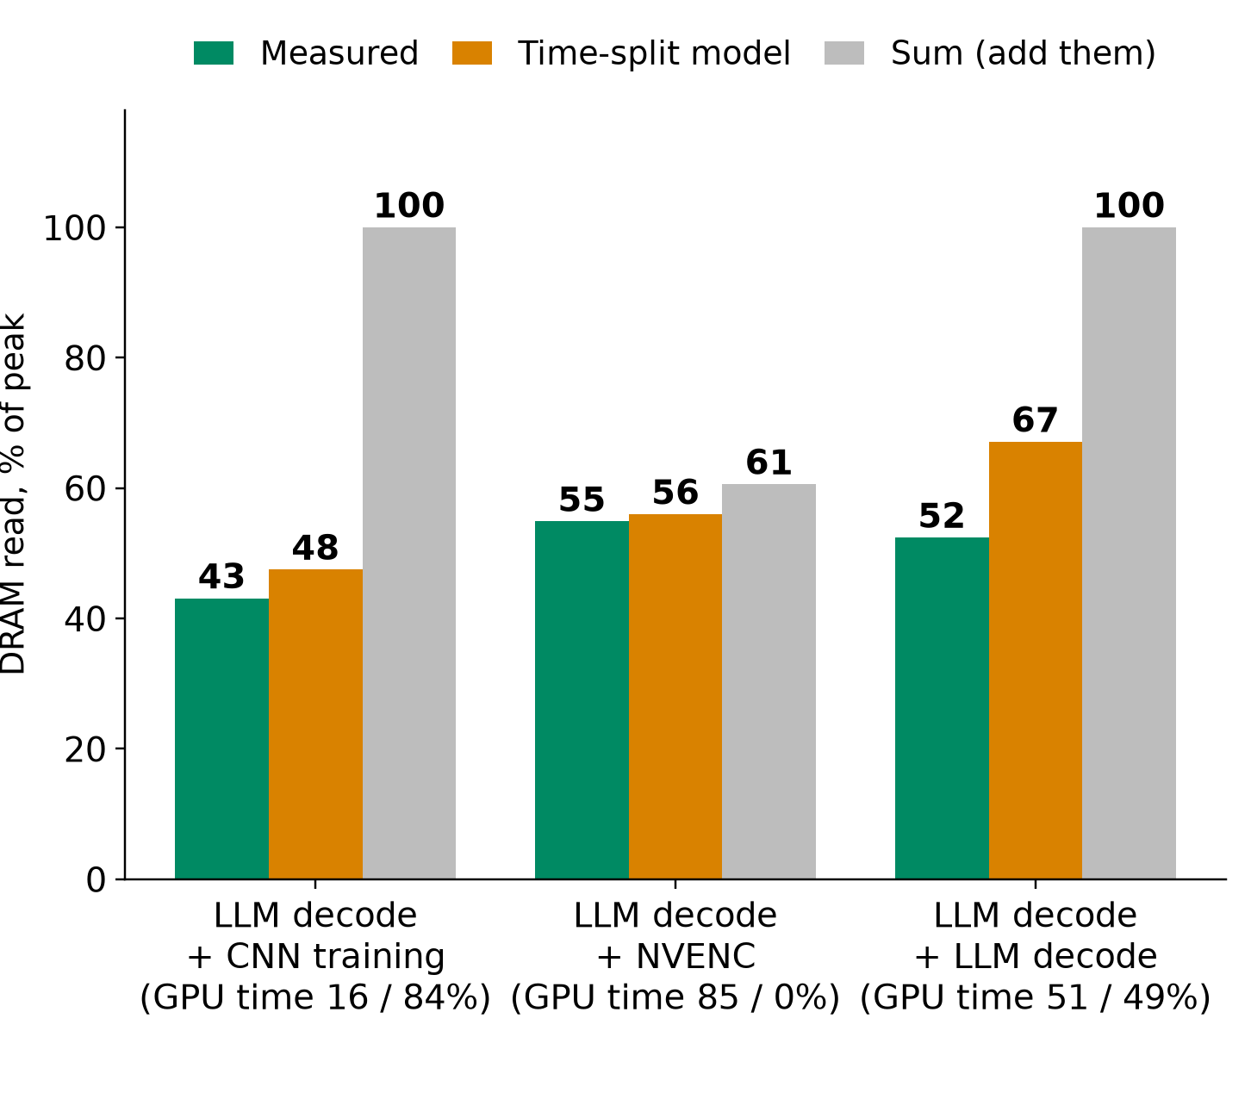
APPENDIX
Time-split model: explains, does not predict
4 separate: 258 tok/s. Batched: 614. Memory 8.9 vs 2.5 GiB. Batch 8 is faster per token than 4 (n=2): recheck
Time-split needs co-run time shares: it explains, not predicts. Share is not slowdown (16% share, x2.08, not x5.7)
Measured on our other machine (RTX 5070 Ti), imported report, unaudited, n=2 to 12: sources/2026-10-16-shared-gpu/report.md (Fig. 2, 3, 4; tables B.1, B.6). DRAM read only. MPS not tested
11j
Notes:
INSERT: optional slide; delete or hide it and the talk flows unchanged
TIME 1:15
SAY: Main points:
- Left: DRAM read bandwidth of A+B measured, from the time-split model, and from summing
- Time-split is close, but its inputs are the time shares, which only exist after the co-run
- The 2 to 22% switching loss is the leftover, computed on DRAM read only
- Right: qwen2.5 3B, 256 tokens, separate processes lose to batching
- NVIDIA MPS exists to cut context switching and GKE offers it, we did not test it
Supplemental points:
- Other counters differ: SMs active for LLM+LLM is 21% off, DRAM write is negative

Slide 22
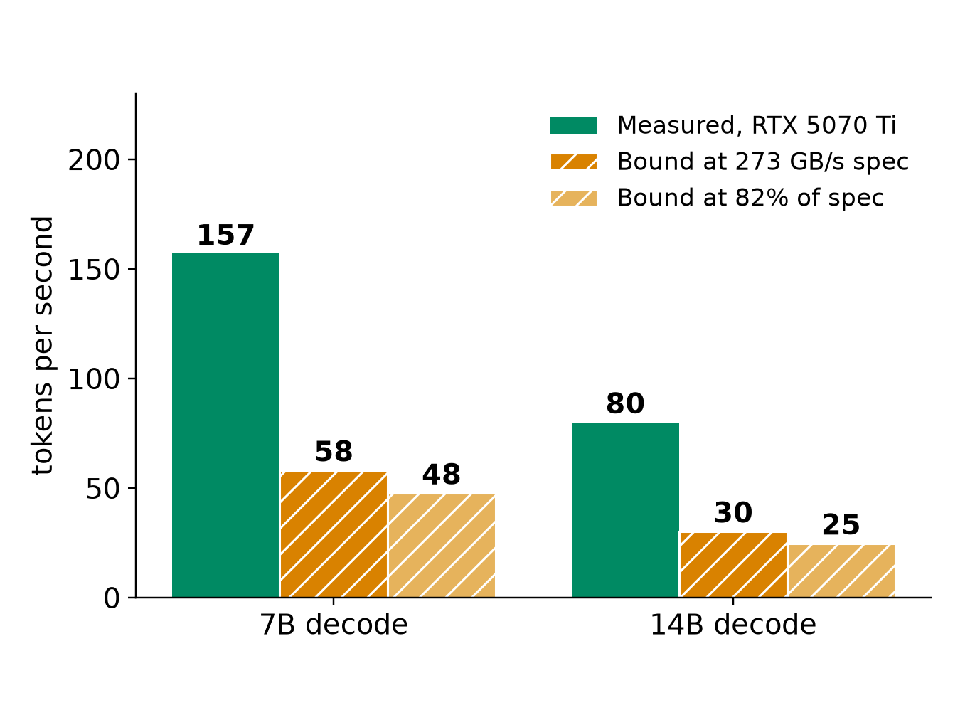
APPENDIX
Decode bandwidth bound at the GB10 spec
• 7B reads about 4.7 GB per token: at most 58 tok/s at 273 GB/s, 48 at the 5070 Ti's 82% efficiency
• 14B reads about 9.0 GB: 30 and 25
• Assumes decode stays bandwidth-bound and CPU traffic is zero
• Batching raises total tokens above this: weights are read once per batch
• An MoE model differs (qwen.code30b: 3.3B active)
Measured on our other machine (RTX 5070 Ti), imported report, unaudited, n=2 to 12: sources/2026-10-16-shared-gpu/report.md (B.3). Bytes per token = model file size = decode GB/s over tok/s. Bound = arithmetic at 273 GB/s, not measured
11k
Notes:
INSERT: optional slide; delete or hide it and the talk flows unchanged
TIME 0:30
SAY: Main points:
- This is arithmetic from our file sizes, not a GB10 measurement

Slide 23
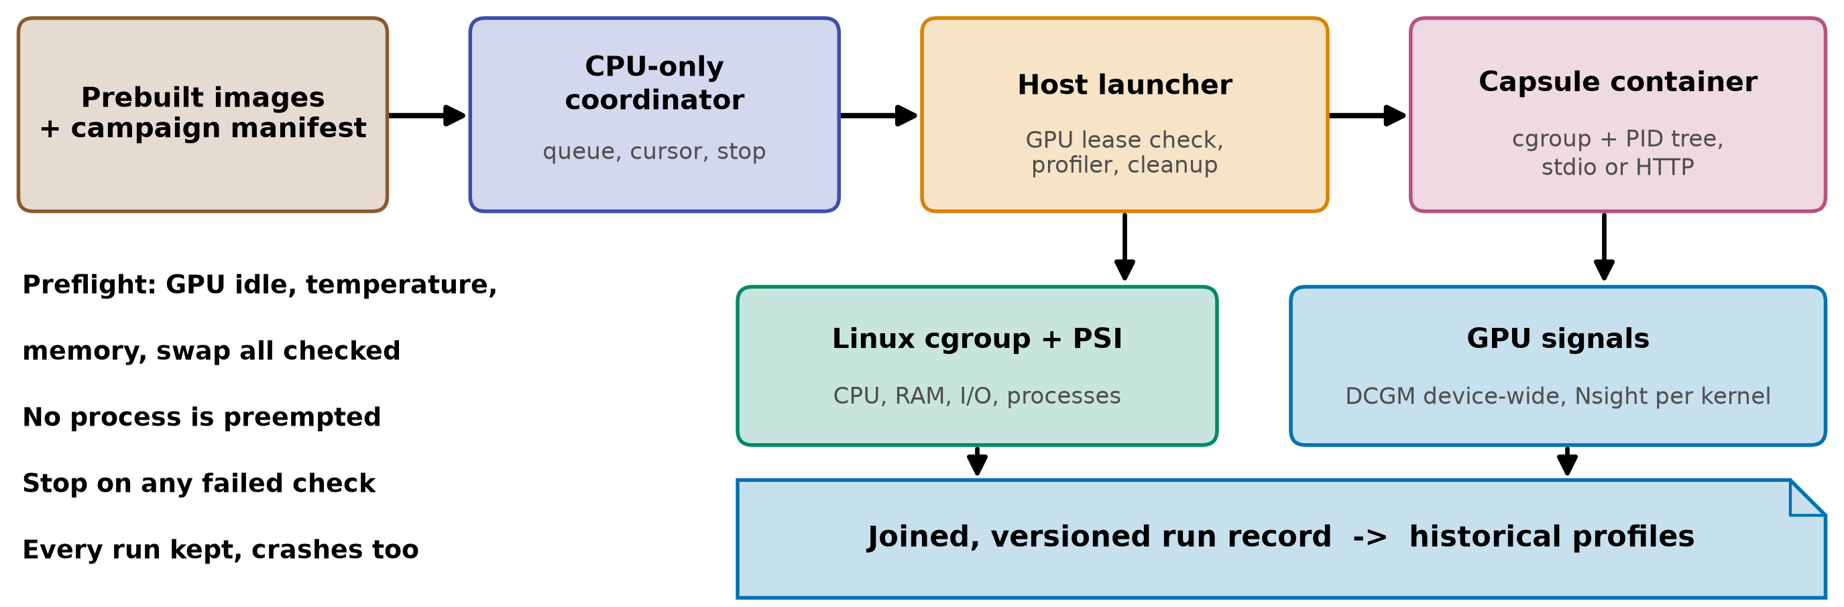
APPENDIX
How a quiet-window run could work (proposed)
The image gives us | It does not give us | Cost and constraint
Digest as executable identity, repeatable environment | Exclusive GPU, deterministic timing | +216 ms per GPU start (219 total); +245 ms with a 340 ms task
cgroup and PID-tree accounting | Kernel metrics scoped to the container | Window on the single product host (D35). Launcher never preempts
Same packaging unit as the Paper2Agent proposal | Any change to the capsule declaration | Sidecar README:107 excludes profiling integration today
gb10-profiling-plan.md; NVIDIA Container Toolkit; Slurm job arrays; sidecar/README.md:103,107; owner-rulings.md:123; startup: Measured on our other machine (RTX 5070 Ti), imported report, unaudited, n=2 to 12: sources/2026-10-16-shared-gpu/report.md
11l
Notes:
INSERT: optional slide; delete or hide it and the talk flows unchanged
TIME 1:15
SAY: Main points:
- Containers do not make GPU counters per container, the quiet window does
- Prebuild images, run serially, stop on any failed preflight, never preempt a running job
- The GB10 is the only M1 product host, so a window is a scheduling decision
- Keep the Docker socket out of the capsule, the host launcher owns profiler and cleanup
Supplemental points:
- arm64 and amd64 images are different environments and are recorded separately
- AGX Orin study (HiPC 2023) found small container overhead for its setup, so we measure ours

Slide 24
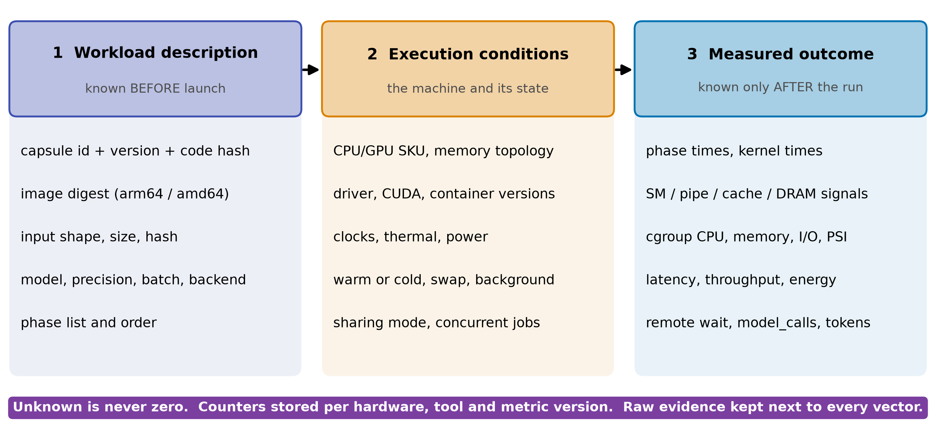
APPENDIX
Three linked records, versioned like the capsule
• Invalidate on: new declaration_sha256, image digest, driver or firmware change
• RSI child: inherits memory_mb, not its profile. Re-profile before use
• Unprofiled capsule: unknown, never zero. Planner falls back to declared exclusive or serial
gb10-profiling-plan.md, future data contract; design-package/reference/declaration.md (declaration_sha256), side-systems/rsi-workbench.md
11m
Notes:
INSERT: optional slide; delete or hide it and the talk flows unchanged
TIME 1:00
SAY: Main points:
- Description is known before launch and is the only input to pre-launch prediction
- Conditions describe the machine, counters are stored per hardware and tool version
- Outcome is after the run and never an input to the same run's prediction
- A new capsule version is a new identity, so its record starts empty
Supplemental points:
- Start with nearest neighbor on understandable features, preserve phase order
- Chakra is a training-trace format, reuse only what maps to capsule phases

Slide 25
APPENDIX
If we later try a predictor: how we would test it
Claim | Inputs allowed | Test | Pass if
1 Before launch | Solo features only: kernel median, GPU busy, launch rate, plus DRAM and tensor % if test 1 finds them | Leave one task family out, predict pair slowdown | Beats B0 and B1 on slowdown error and pairing choice, by more than the repeat spread
2 After a short prefix | Plus a bounded profiling run | Same split, report profiling cost | Error falls enough to pay for the prefix
3 Changed hardware | Plus a hardware model | Not tested here | Needs a calibrated simulator
• Baselines: B0 no interference (x1). B1 one-bit GPU-heavy label. B2 nearest neighbor. Time-split with measured shares is an upper bound, not a predictor
• Spread first: LLM beside training varied x1.7 to x2.4 over two runs, so no error target below that is testable. Measure repeat variance, then the planner owner sets the target. Only 4 task families exist today: leave-one-out is a feasibility check, not a statistical test
• Stop rule: if B1 matches on pairing, ship the label and keep profiles for memory and routing
literature/README.md (NeuSight ASPLOS 2025, Orion EuroSys 2024, SoCC 2025); plan Phase D; Measured on our other machine (RTX 5070 Ti), imported report, unaudited, n=2 to 12: sources/2026-10-16-shared-gpu/report.md
11n
Notes:
INSERT: optional slide; delete or hide it and the talk flows unchanged
TIME 1:15
SAY: Main points:
- Three separate claims, never mix a finished run's counters into a pre-launch prediction
- Hold out whole task families and hardware, not repeats of the same run
- Baselines include a one-bit label because the planner example showed it can be enough
- The program has a stop rule, so the funding ask has an exit
Supplemental points:
- The error target is not set: it must exceed the repeat spread
- SoCC 2025 (Elvinger et al.) gives resource-specific sensitivity methods we can reuse

Slide 26
APPENDIX
Vendor practices and our data, tagged
Do | Backed by | Avoid | Because
Profile solo in exclusive windows | DCGM profiling conflicts with Nsight (NVIDIA) | Per-container GPU shares from device counters | Counters are device-wide
Key records by declaration hash, image digest, machine | NVIDIA Container Toolkit, OCI; CC identity | Comparing percentages across chips | Utilization is not headroom
Keep phases: startup, cold, steady | Ours, 5070 Ti, GB10 pending: 64 s vs 5 s | One averaged vector per task | Averages hide peaks
Pair by resource class, test against a label | Orion; ours, 5070 Ti, GB10 pending: x2.08 vs x1.02 | Summing utilization | Time-split fits 3 pairs
Batch, do not clone, model servers | Ours, 5070 Ti, GB10 pending: 614 vs 258 tok/s; GKE offers MPS | Treating GB10 memory as VRAM | One pool, no VRAM counter
NVIDIA DCGM, MPS, Container Toolkit docs; Orion EuroSys 2024; GKE MPS guide; Measured on our other machine (RTX 5070 Ti), imported report, unaudited, n=2 to 12: sources/2026-10-16-shared-gpu/report.md
11o
Notes:
INSERT: optional slide; delete or hide it and the talk flows unchanged
TIME 1:00
SAY: Main points:
- Every row names where it is used or measured, and which rows still wait on the GB10
- The avoid column is the failure modes from the literature and from our numbers
Supplemental points:
- Also avoid exhaustive combination sweeps and collecting every counter

Slide 27
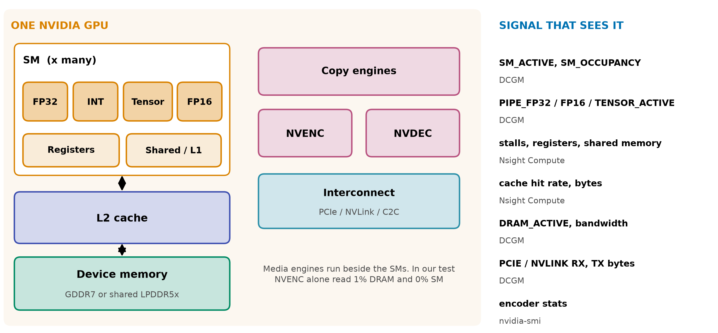
APPENDIX
Six GPU resources, six different signals
NVIDIA DCGM profiling fields; AWS CloudWatch encoder stats; NVENC read 1% DRAM, 0% SM: Measured on our other machine (RTX 5070 Ti), imported report, unaudited, n=2 to 12: sources/2026-10-16-shared-gpu/report.md (B.5)
11p
Notes:
INSERT: optional slide; delete or hide it and the talk flows unchanged
TIME 0:30
SAY: Main points:
- Media engines run beside the SMs, in our test NVENC alone read 1% DRAM and 0% SM

Slide 28
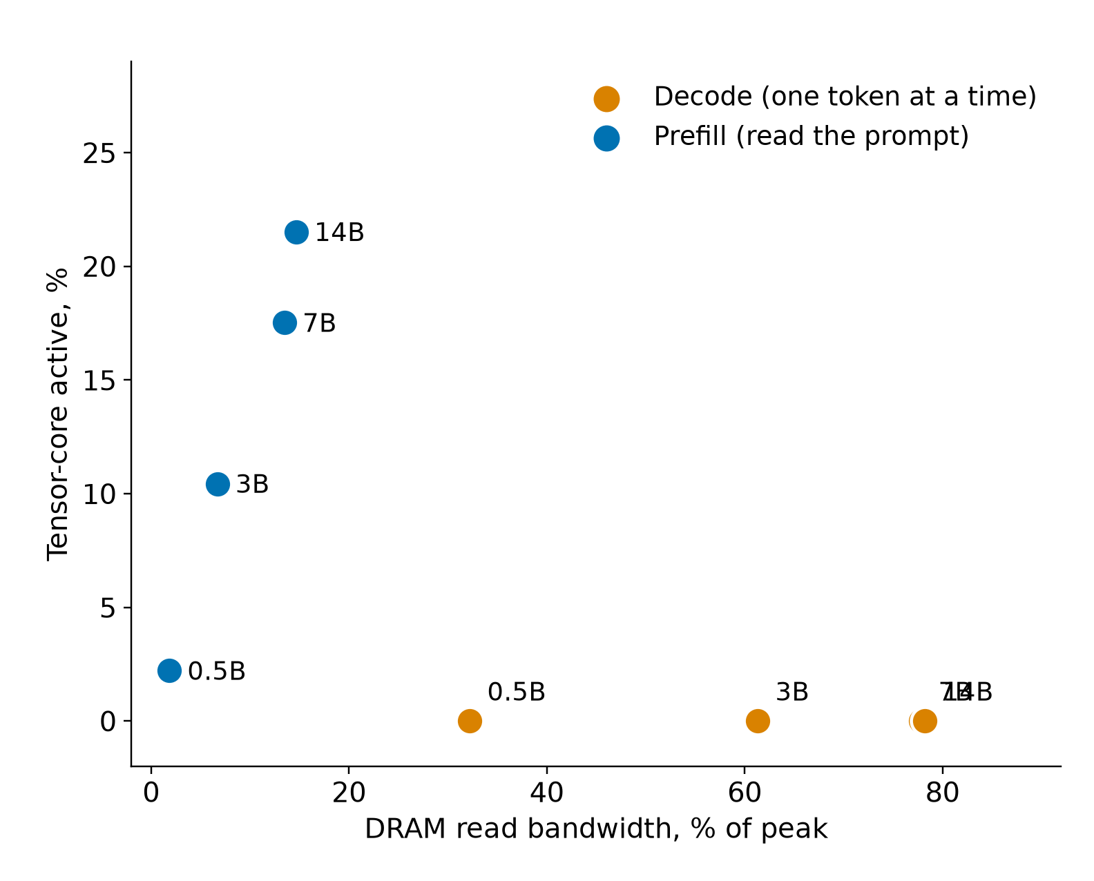
APPENDIX
Decode is memory-bound: 7B reaches 87 to 96% of ceilings
Model | Decode tok/s | Decode DRAM | Prefill tok/s | Prefill tensor
0.5B | 738 | 32% | 31,726 | 2%
3B | 283 | 61% | 10,709 | 10%
7B | 157 | 78% | 6,590 | 18%
14B | 80 | 78% | 3,397 | 22%
• Speech-to-text and NVENC: 0 to 3% on every counter
• 7B partial offload: 157 tok/s all-GPU, 22 at 20 of 28 layers
Measured on our other machine (RTX 5070 Ti), imported report, unaudited, n=2 to 12: sources/2026-10-16-shared-gpu/report.md (Fig. 8, tables B.3 and B.5). Decode GB/s = model file bytes x tok/s; ceilings: 850 GB/s matrix-vector, 770 GB/s copy (B.7)
11q
Notes:
INSERT: optional slide; delete or hide it and the talk flows unchanged
TIME 0:30
SAY: Main points:
- Records need both memory and compute dimensions

Slide 29
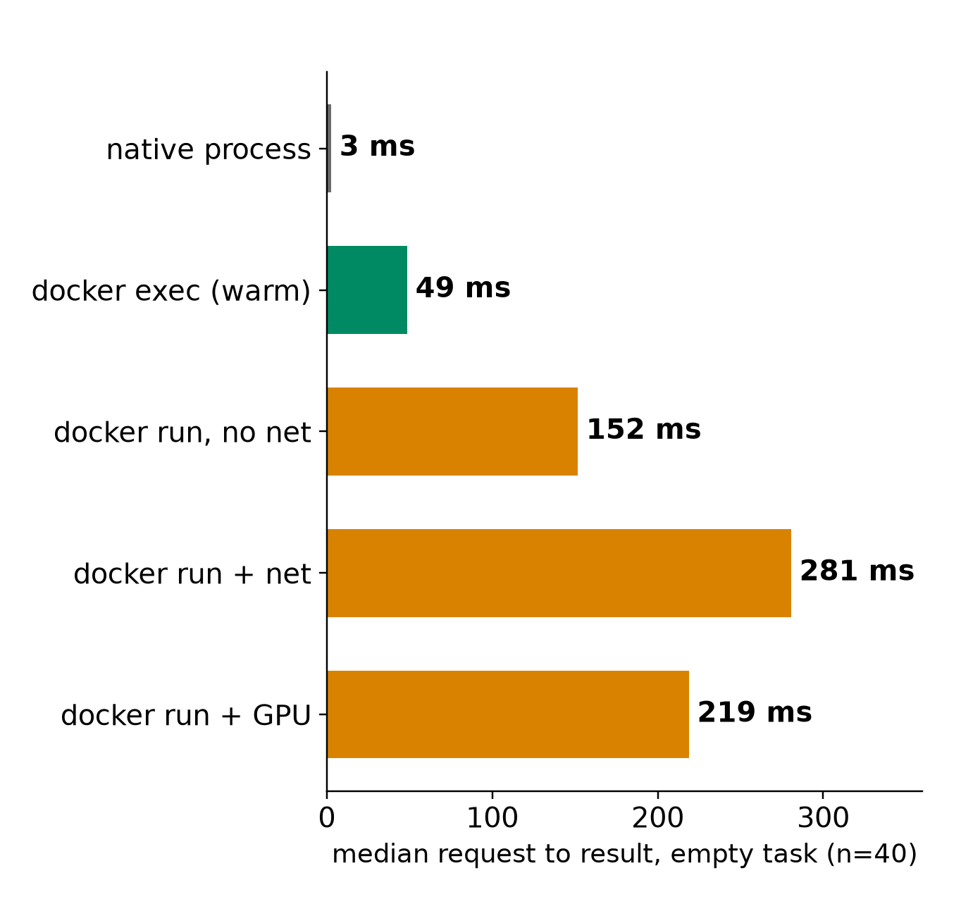
APPENDIX
Startup is its own phase: +216 ms, 64 s vs 5 s
• Overhead per GPU start: +216 ms empty, +245 ms with a 340 ms task
• 16 containers at once: about 2.8x slower each
• Fresh Ollama container: 64.4 s vs 5.3 s with a shared GPU-code cache
• 7B first token: 0.049 s loaded, 2.7 s in RAM, 6.1 s from disk
Measured on our other machine (RTX 5070 Ti), imported report, unaudited, n=2 to 12: sources/2026-10-16-shared-gpu/report.md (Fig. 9 to 13, table B.8)
11r
Notes:
INSERT: optional slide; delete or hide it and the talk flows unchanged
TIME 0:30
SAY: Main points:
- Profile cold and warm separately and label which one a record is

Slide 30
APPENDIX
Clouds collect device metrics; labels need Kubernetes
Provider | Path | What it collects | Attribution
AWS | CloudWatch agent, nvidia_gpu block | nvidia_smi_* utilization, memory, temperature, PCIe, encoder stats | Instance level, needs driver and nvidia-smi
Google GKE | Managed DCGM to Managed Prometheus | 21 metrics: GPU util, SM, FP16/32/64 and tensor pipes, DRAM, PCIe, NVLink, power | container, pod and namespace labels on every metric
Microsoft AKS | DCGM exporter to Managed Prometheus and Grafana | Utilization, memory, temperature, power | Per scrape of GPU node pools
AWS CloudWatch agent NVIDIA GPU page; GKE DCGM metrics page; AKS monitor-gpu-metrics page
11s
Notes:
INSERT: optional slide; delete or hide it and the talk flows unchanged
TIME 0:30
SAY: Main points:
- Same device metrics everywhere
- Only Kubernetes labels give workload attribution

Slide 31
APPENDIX
Prior work: what to reuse, what is still open
Prior work | Reuse | Still open here
Utilization prediction, HotCloud 2020 | Graph features, no per-job profiling | Coarse busy, not per component
NeuSight, ASPLOS 2025 | Tile-level latency across GPUs | Not stress for arbitrary tasks
Orion, EuroSys 2024 | Kernel profiles for sharing | Predicted, not measured, profiles
GPU Resource Interference One Level Deeper, SoCC 2025 | Resource sensitivity methods | Unseen tasks, agent mix
Accel-Sim, ISCA 2020; Chakra 2023 | Simulator; trace format | Calibration on our target
literature/README.md. Links on the source map
11t
Notes:
INSERT: optional slide; delete or hide it and the talk flows unchanged
TIME 0:30
SAY: Main points:
- Reuse code, datasets and trace formats before running new experiments

Slide 32
APPENDIX
What this evidence shows and what it does not
Shows | Does not show
Pairing, batching and cold start effects on one x86 plus RTX 5070 Ti machine | Anything about the GB10 or unified memory
Time-split fits DRAM read on three pairs | That it predicts, or that MPS removes the switching cost (not tested)
Decode is bandwidth-bound across 0.5B to 14B | Prediction accuracy: no predictor built or held out
Container start +216 ms with GPU | Chip-design conclusions: no sensitivity runs
Repeats are small (2 to 12), raw traces and ledger stay on the other machine | NVDEC, NVENC subtitle path, real agent traffic, how much of a real run is local GPU
Measured on our other machine (RTX 5070 Ti), imported report, unaudited, n=2 to 12: sources/2026-10-16-shared-gpu/report.md
11u
Notes:
INSERT: optional slide; delete or hide it and the talk flows unchanged
TIME 0:30
SAY: Main points:
- Everything here was imported from the measuring machine and not independently audited

Slide 33
APPENDIX
Source map
Claim | Source
DCGM device-level profiling, 1 Hz, conflicts with Nsight; job stats | docs.nvidia.com/datacenter/dcgm/latest/user-guide/feature-overview.html
Memory-Usage Not Supported on DGX Spark; GB10 hardware | docs.nvidia.com/dgx/dgx-spark/known-issues.html and hardware.html
GKE DCGM metrics with pod labels; MPS on GKE | docs.cloud.google.com/kubernetes-engine/docs/how-to/dcgm-metrics and nvidia-mps-gpus
AWS CloudWatch NVIDIA GPU; Container Insights EKS and ECS | docs.aws.amazon.com/AmazonCloudWatch/latest/monitoring/CloudWatch-Agent-NVIDIA-GPU.html
AKS DCGM exporter; NVIDIA MPS | learn.microsoft.com/en-us/azure/aks/monitor-gpu-metrics; docs.nvidia.com/deploy/mps/latest/index.html
Orion; SoCC 2025 interference; HotCloud 2020 | anakli.inf.ethz.ch/papers/orion_eurosys24.pdf, gpu_interference_socc25.pdf; usenix.org hotcloud20_paper_yeung.pdf
NeuSight; Accel-Sim; Chakra; HiPC 2023 Orin | doi.org/10.1145/3669940.3707265; doi.org/10.1109/ISCA45697.2020.00047; arxiv.org/abs/2305.14516, 2312.07220
CUDA Unified Memory behavior | NVIDIA CUDA Programming Guide, Unified Memory section (docs.nvidia.com/cuda)
Declaration, records, planner, checks, RSI, sidecar, owner rulings | design-package/reference/*.md, checking/README.md, side-systems/rsi-workbench.md, side-systems/owner-rulings.md, development-tools/sidecar/README.md
Paper2Agent container proposal (packaging unit) | arxiv.org/abs/2509.06917; AI4Research_private_planning/ai4r_muk/paper2agent-reference/06-paper2agent-cc-container-proposal.md
Accessed October 2026. design-package paths are under jiuwenswarm/docs/architecture/
11v
Notes:
INSERT: optional slide; delete or hide it and the talk flows unchanged
TIME 0:10
SAY: Main points:
- Source list

